Slide 1
Feature-based Word Embeddings
CIS 530 - Computational Linguistics

Slide 2
The Problem
We want to measure how the semantic information of words varies with the document attributes, such as publication date, topic and writer's age.
So in this project we implement a method to train dynamic word embeddings based on document attributes, thereby training three-dimensional word embeddings that capture specific features of each word in the context of the input dataset.
We extend some previous work(year-specific word embeddings) and train word embeddings based on novel features on a blog authorship corpus.

Slide 3
Significance and Relevance
What makes this project interesting?
The general purpose word embeddings can be useful in many applications, such as searching engine, recommendation system, machine translation, etc.
E.g. by training word embedding on the blog dataset, we can find how the meaning of word 'amazon' change from the forest to the company and how the popularity of a celebrity changes with time or author's age
How this project is related to CIS 530 content?
We implemented methods and algorithms introduced in the class during training and evaluation. In HW4, we implemented term-context and PPMI matrices. We’ve also worked with other word embeddings. The paper we are implementing was introduced in class.

Slide 4
Previous Works
Word embeddings have been studied from the perspective of semantic changes over time:
Yao et al. (2018): a dynamic model that learns time-aware word vector representation (NYT 1990 - 2016, PPMI, block coordinate descent)
Garg et al. (2018): temporal dynamics of embeddings quantifies changes in gender and ethnic stereotypes (Google News word2vec, Google Books/COHA, NYT GLoVe; occupation, adjectives)
And domain-specific word embeddings:
Lee et al. (2019): adapted BERT for biomedical corpora
Zhang et al. 2019): subword embedding model for biomedical word vectors
Dollah et al. (2019): used Convolutional Neural Network to perform classification of biomedical text
But semantic change over domains/topics has been relatively under-studied.

Slide 5
The Data
The Blog Authorship Corpus contains over 680,000 posts from 19,320 different bloggers spanning ages between 13 to 47, topics ranging from banking to technology.
Each row contains the post ID, gender and age of the blogger, topic of the post, publication date and the raw blog text.
Sample table format
The data was obtained at Kaggle.com and saved as a .csv file for further preprocessing.
ID | gender | age | topic | sign | date | text
0012 | female | 24 | food | Aries | 14,May,2004 | I ate pizza today and...

Slide 6
Preprocessing
The blog corpus contains lots of noisy data that must be pre-processed to generate a PPMI matrix over the vocabulary set.
Removal of null values, short posts, foreign languages, ill-formatted data
Extraction of date/age information
Removal of posts within under-represented categories (date, age, topic)
Tokenization and Lemmatization using perceptron-based POS taggers and WordNet from NLTK
Construction of vocabulary set, filtering outlier words in terms of frequency
Generation of term-context matrix using a sliding window
Computation of PPMI matrix over different values of user-defined feature
The PPMI matrix is used as an input to a customized loss function that trains feature-dependent word embeddings.

Slide 7

Training Algorithm
Basic: PPMI matrix
Cross-time model: solution for the optimization problem
Intuition:
Penalty in the optimization function: Word embedding for a specific time should not be too different from adjacent times
The word embedding in a certain context is close to its PPMI matrix
Challenges: how do we set the penalty function for cross-topic word embeddings?

Slide 8
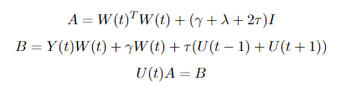
Training Algorithm
Block coordinate descent (BCD): fast but not guaranteed to converge
Stochastic gradient descent (SGD): slow but guaranteed to converge
We used BCD to speed up the training process, updating two arrays U(t) and W(t) simultaneously and used U(t) for the word embeddings over time.
Both U(t) and W(t) were initialized to contain random numbers between 0 and 1, with shape |vocab| x |new embedding dimension|.

Slide 9
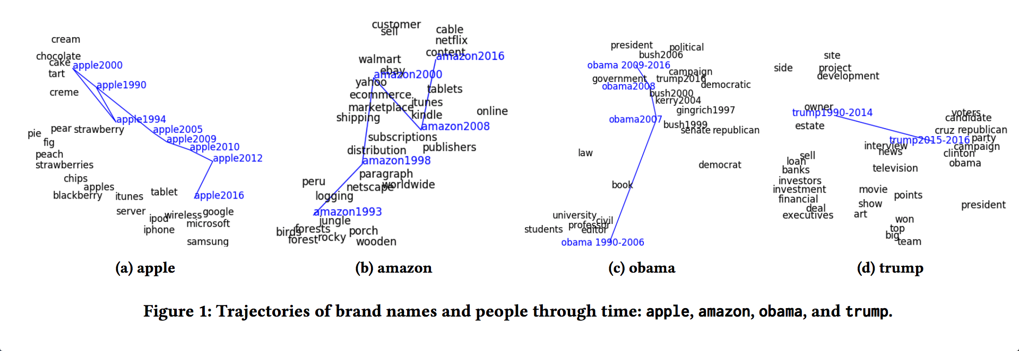
Evaluation Methods
Quantitative: Semantic similarity
Are similar words close together?
Qualitative: Trajectory visualization

Slide 10
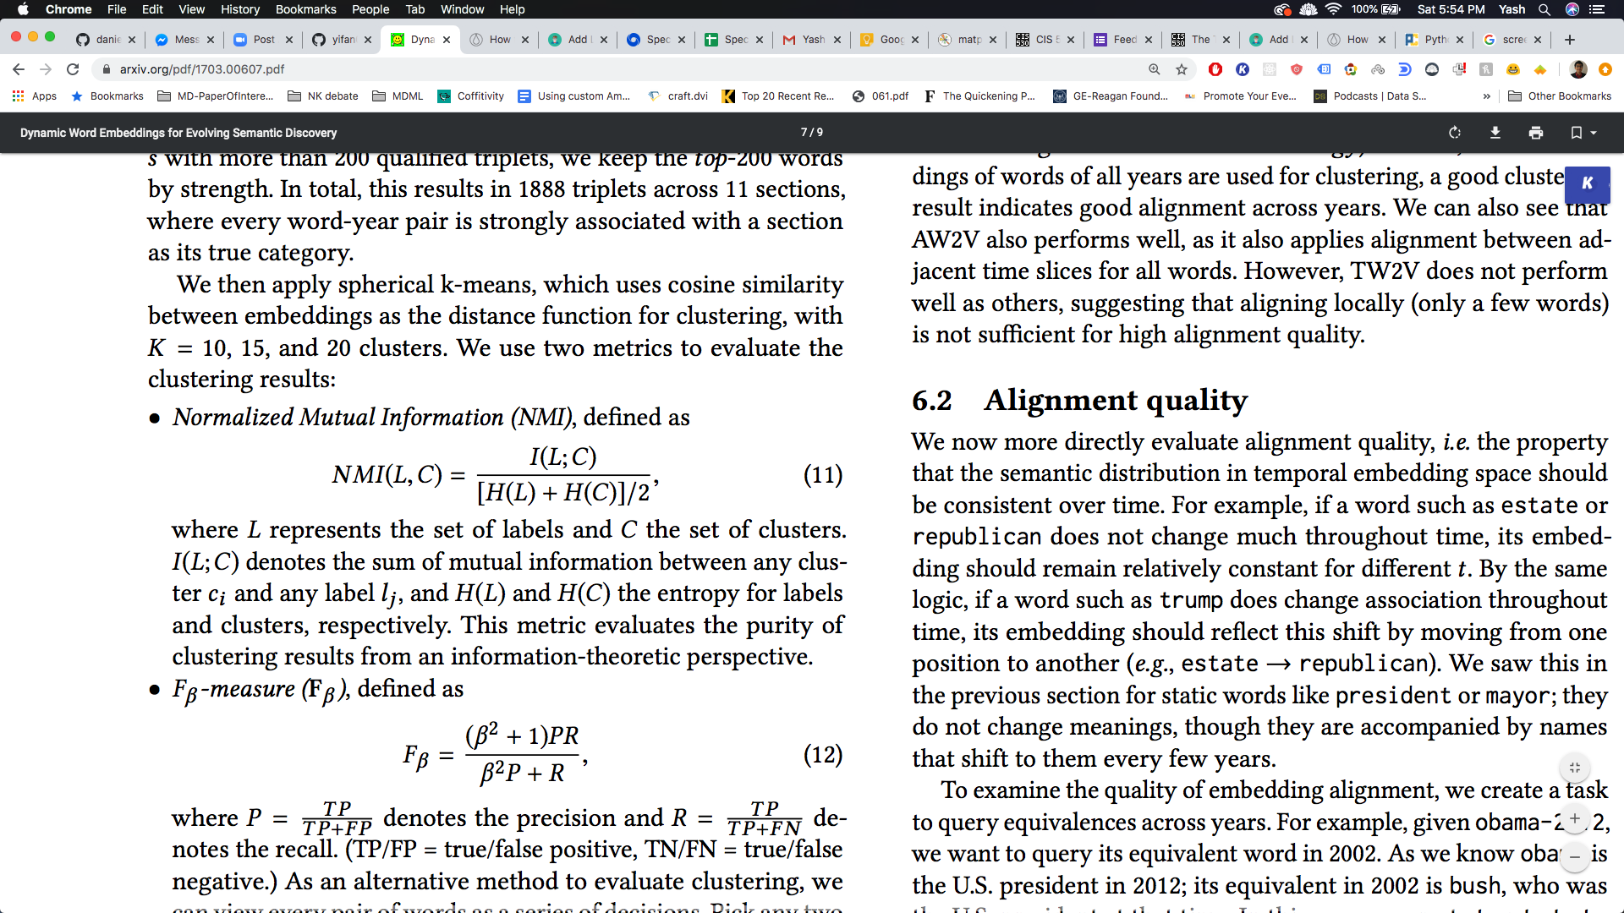
Simple Baseline: Quantitative Analysis
Baseline word embeddings were directly extracted from PPMI matrices.
Create triples of (word, time, topic)
Use spherical k-means to cluster the words
How well do clusters based on embedding and time match the topic labels?
Normalized Mutual Information
Fᵦ
NMF: 0.0922
F_beta: 24.15
Notes:
Explain what these metrics mean.
The first is how much more a label/cluster is if we know it is in a particular label/cluster, normalized to one.
The second is a relative measure of precision and recall.

Slide 11
Published Baseline: Qualitative Analysis
The labels for the NYT dataset are not available
However, the PPMI matrices are, so we could still train embeddings
We evaluated using the qualitative Metric instead
Trajectory Visualization
Shows how word meaning evolves over time
Find the nearest neighbors at each time slice
Plot 2D t-SNE projection

Slide 12
t-distributed Stochastic Neighbor Embedding (tSNE)
A visualization algorithm that balances between global and local structure
Takes a parameter, perplexity, which governs that trade-off
Usually between 5-50
Notes:
Give a brief overview of https://distill.pub/2016/misread-tsne/, which discusses the nuances of interpreting tSNE projections

Slide 13
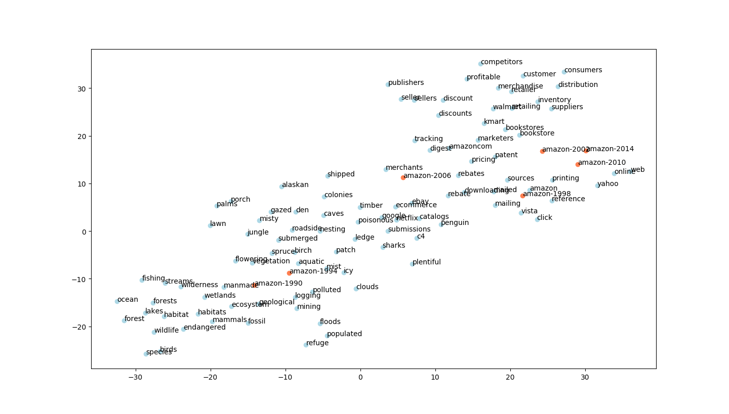

Slide 14
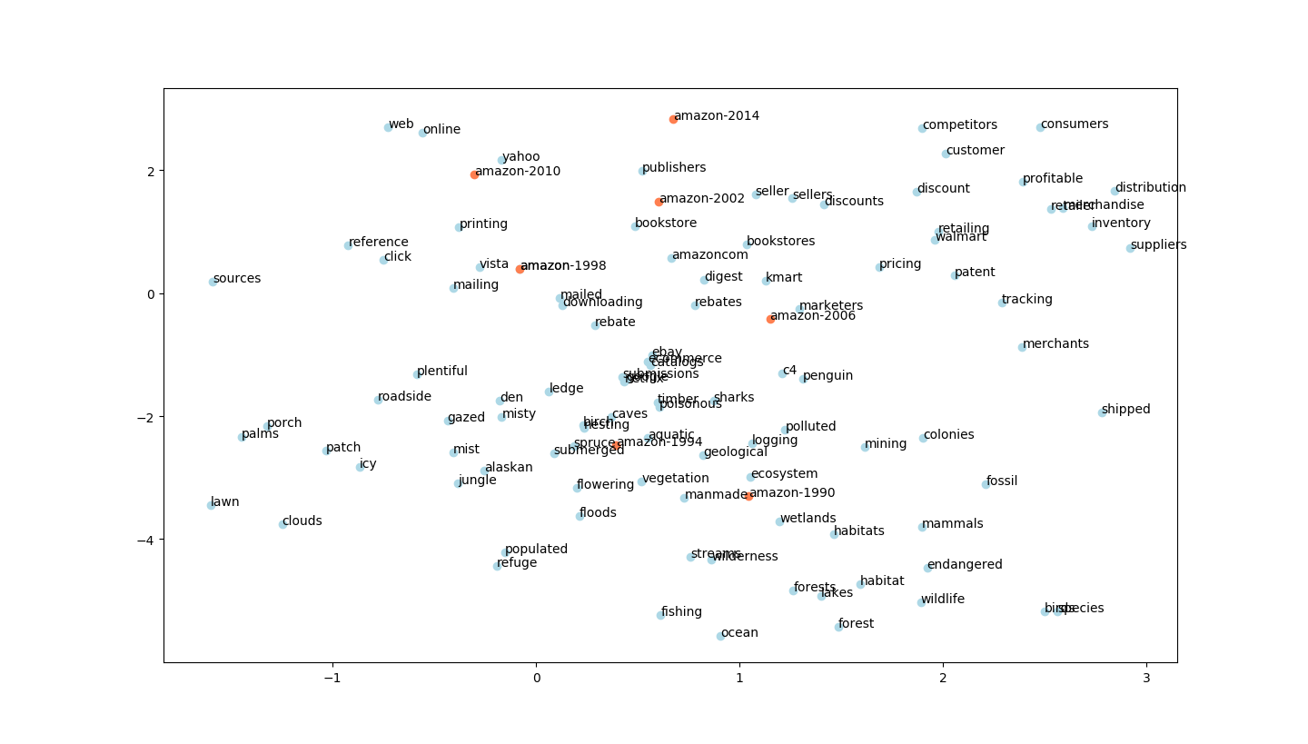
Notes:
Compare this slide and the previous one.
The previous slide more strongly weights the global structure (perplexity=10), this one more strongly weights the local structure (perplexity=45). This is reflected in a number of ways, e.g. the linearity/non-linearity of the path amazon takes over time.
Also note how these two lend themselves to two different stories, and how the paper we implement this baseline from perhaps delves a bit too deep into what is probably and artefact of the tSNE projection.

Slide 15
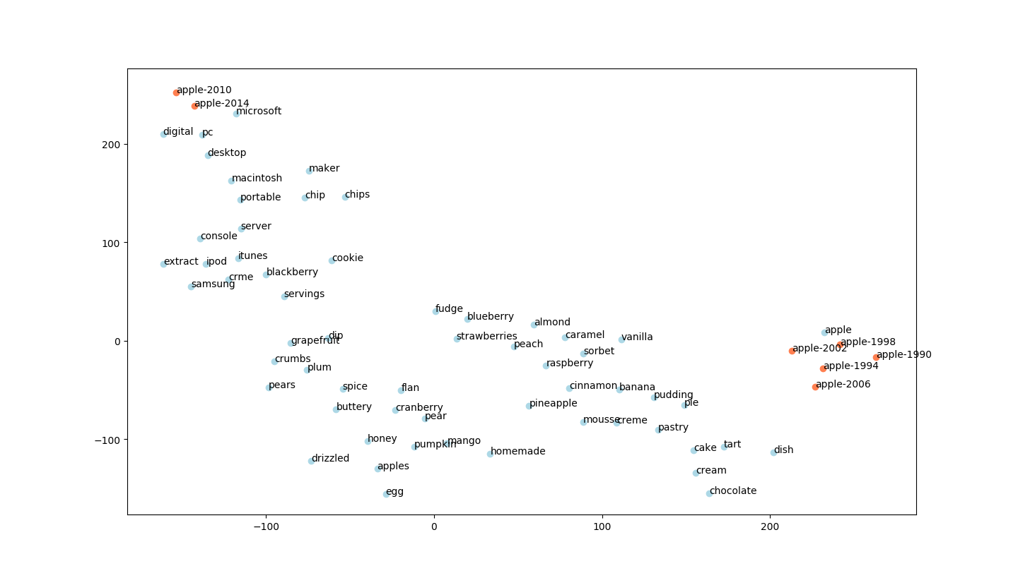
Notes:
Apple shifts to being a tech giant after 2006, which is probably related to the release of the iphone in 2008. (Note, this is a different story than what the paper tells, which is an earlier inflection when Jobs returns to microsoft; however, they focus more on the local structure, we focus more on the global structure. This difference leads to the different stories.)

Slide 16
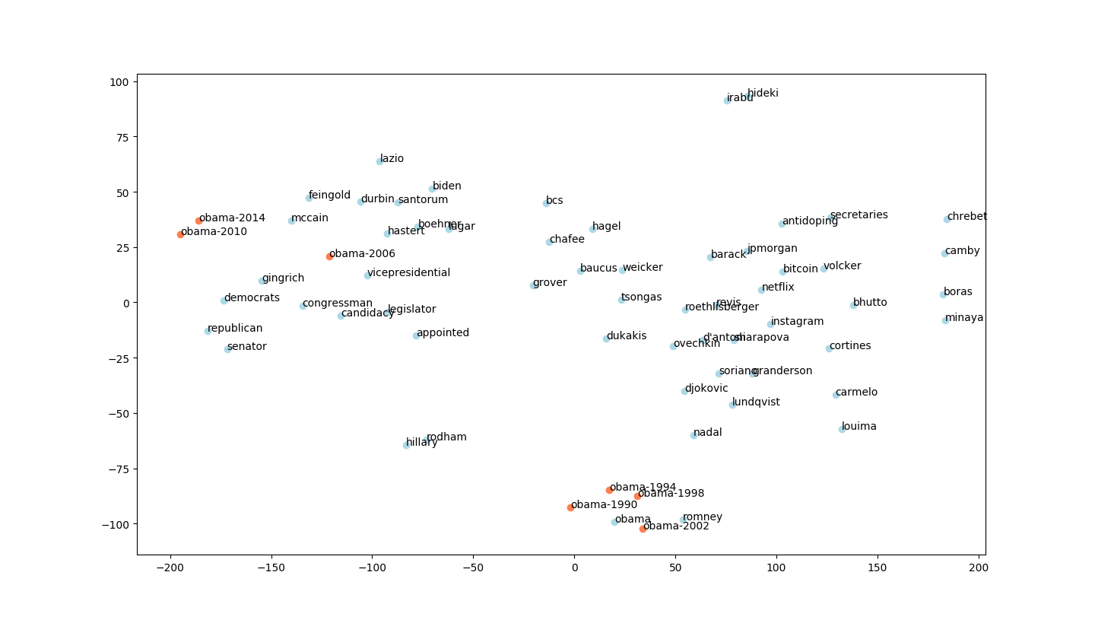
Notes:
Here, we do actually get a similar story to the paper!

Slide 17
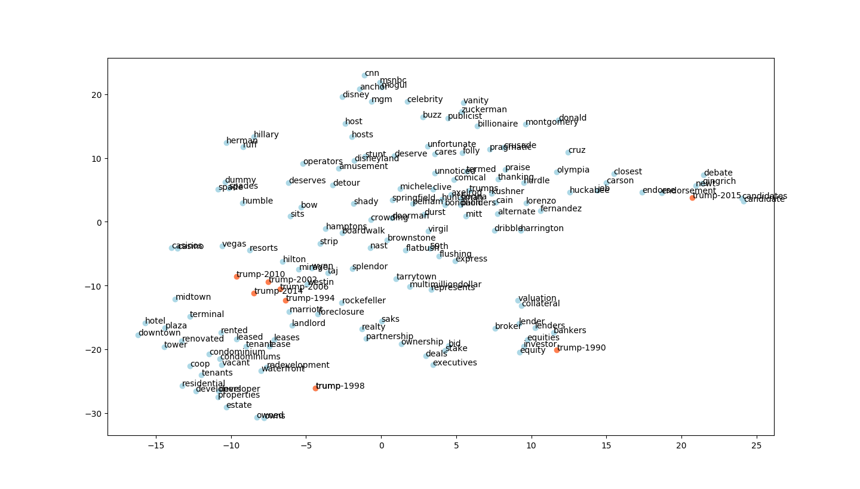
Notes:
Exactly the same story here!
The most important thing to note here is that the method for generating embeddings is so powerful that it can capture these changes over time. Even if the precise story differs based on the parameters for visualization, it does encode a lot of temporal information, so it’s a very successful method.

Slide 18
Link to Github repo
https://github.com/danieljkim0118/doc-word2vec
The instructions to run the baseline evaluation are in baseline.md

